Slide 1


A Conversation of Possibility
Prepared for: Tim Hart , Jennifer Hill
All materials and methodologies are copy written and protected Intellectual Property of Kate Burda & Company and for the express purpose for Kalibri Labs, systems, and constructs are not for external distribution and are protected.

Slide 2
We create impact
WHAT YOU CARE ABOUT…
Building out the ”Revenue Trifecta” Marketing is the last of the piece of the commercial puzzle.
Marketing structure that starts at the foundational level and builds to a more evolved state (Crawl, Walk, Run).
Get things done, while we are building the structure. (Build the plane in flight).
Leveraging what Kalibri already has within thought-leadership, brand, and core areas to a programmatic way to enable sales and client services.
WHAT YOU GET…
‘Vision-to-Value’ roadmap focused on revenue outcomes attached to marketing strategy.
Proven and Pragmatic Approach in a go-to-market strategy.
Build the foundation and beyond, “Know me, Show me, Grow me”
Depth and Expertise in the core areas of marketing:
Brand
Awareness
Targeted
SO YOU CAN…
Sales enablement
Reduce churn
Have a marketing roadmap that is aligned to your strategic plan, vision, and principles.
Build the foundation, yet get rolling on initiatives quickly.

Slide 3
The Marketing Workstreams
BRAND
Takes a look at your brand, how it is positioned, the competitive landscape, and the white space. We look at voice of customer, Kalibri’s differentiator and overall tone of marketing communications.
AWARENESS
Vision-to-Value
Roadmap
Looking both internally and externally at:
Creating overall brand awareness through multiple channels focusing on how do we create awareness with the customers that mean the most to us given our strategic plan
TARGETED
Segmenting and understanding your business to have targeted and effective communications. Adopting customer buying journey information to look at how Kalibri connects to those that mean the most to your business.

Slide 4

We take the noise, disruption, frustration and complexity of the new economy and bring you a clear, concise and simple path for you to get results.
Bringing Simplicity to Your Complexity
3

Slide 5
5 Step Rapid Return Roadmap
From Insight to Impact
2- Insight Intelligence
4- Drive & Sustain
Bringing you the insight to get you where you
need to go
Sustainability and future planning, elimination of churn and other SaaS variables
3- Install, Enhance
& Elevate
5- Measure & Equip
1- Differentiation Diagnostic
Measurement of results, KPI’s, readjusting and moving to the next level
A deep dive into the current state that looks at;
what is working, what needs to be left behind, and what needs to be built
Let’s go to work!

Slide 6
Strategic Engagement Deliverables
1- Current State –
Discovery & Analysis
2- Building the
Future State
3- Install, Enhance,
& Elevate
4- Drive & Sustain
5- Measure & Equip
Insights, Findings and Recommendations
Vision-to-Value Roadmap
Implementation and work output, resource allocation, and time commitments
Sustainability Program, Maturation Modeling
Benchmark Scorecard, KPIs
Deliverables

Slide 7

Investment for Performance
The table represents the work that is being done, the deliverables, timeframe, and the investment for the first phase of “Current State”.
This provides an example of work done in similar projects will be adjusted and modified for Kalibri and will be outlined specifically within the scope of work.

Slide 8
Investment for Performance (cont.)
The corresponding table represents the the cost of ‘Building the Future State” / Vision-to-Value roadmap
This cost can shift depending on the scope of work. This cost is representative of the illustrative on the preceding page.
If Kalibri moves forward with Kate & Co for the remainder of engagement a 10% of the initial investment will be applied.

Slide 9
&Who we are

Slide 10
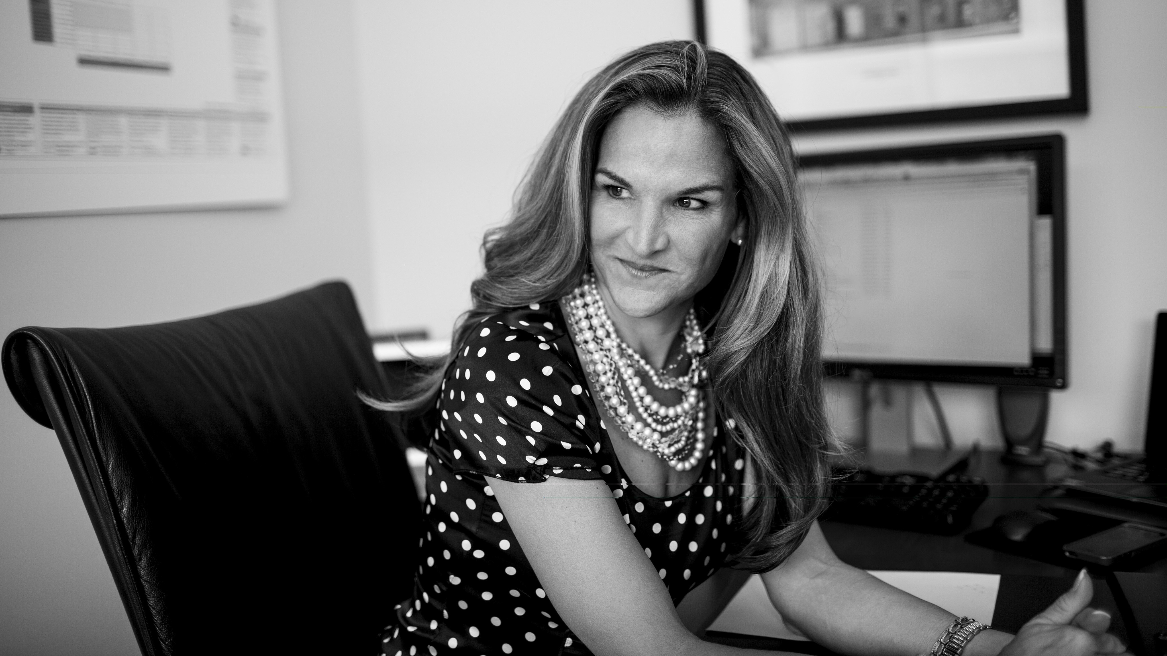
Experience is at the core
&
Kate brings 28+ years’ experience leading and transforming commercial teams within national and multi-national companies. Notable accomplishments:
Experience leading transformation, design, and delivery from branding, to revenue performance.
Increased revenue for Full-Service, Select, Extended Stay, Brand and Franchise hotel properties including: Marriott, Loew’s, Independent Hotels, IHG, Hyatt and Starwood, CSM, American Residential Properties and more.
Lead revenue transformation within B2B companies, such as; Ricoh, Boehringer Ingelheim, Medtronic, Johnson & Johnson, and Indeed.
Headed long-running strategies with start-ups, growth acquisition, market shifts, downturns and disposition.
Developed marketing programs to infuse emerging markets and media into sales opportunities.
Led acquisitions revenue through the full lifecycle: due diligence to exit strategy.
Professor at Fairleigh Dickenson for Revenue Management and Distribution Systems, Global Marketing, and Digital Marketing.
Board member at Boutique and Lifestyle Lodging Association (BLLA), Member and Vendor with Strategic Account Management Association (SAMA)
An active member of Women Owned Businesses (WBENC).
Active member at ISHC, Marketing Committee Member
Is fanatical about bringing clarity to build their future and build connection to customers to be better than they were before.

Slide 11
&In good company

Slide 12





















Companies that have taken this journey...
Financial Services & Asset Management- Hospitality Investment
Healthcare & Life Sciences
Hospitality & Tourism
Commercial, Real Estate, Single Family / Multi Family
CPG,
Manufacturing,

Slide 13






Where we serve
Strategic Account Management Association

Slide 14


Thank you

